Slide 1


Evaluation in Visualization
Universidade de Aveiro Departamento de Electrónica, Telecomunicações e Informática
Beatriz Sousa Santos, Universidade de Aveiro, 2022

Slide 2
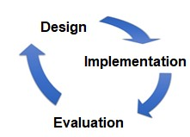

How can we produce a Visualization/ Visual data exploration app?
There are principles (derived form human perception and cognition) and many visualization techniques (we have studied some…)
To obtain efficacy a Human-centered approach is fundamental, involving:
a correct definition of goal and user tasks
(the questions!)
apply adequate methods and evaluate
in several iterations until the goals are satisfied …
2

Slide 3
How can we evaluate?
Many methods can be used to evaluate a Visualization application (some specifically developed, others adapted)
Evaluation methods from other disciplines may and have been adapted and used to evaluate Visualization applications, as methods from:
Human- Computer Interaction
Image Processing
S/W Engineering
3

Slide 4
Applications to visually explore data are interactive and should be usable
Usability is, according to ISO 9241-11:
“the extent to which a product can be used by specified users to achieve specified goals with effectiveness, efficiency and satisfaction in a specified context of use”
How to measure it??
We can use methods used in Human-Computer Interaction
4

Slide 5
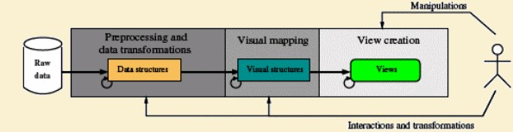
- data transformation
Evaluating a visualization technique should involve evaluation of all phases:
e.g.
low level: accuracy of methods (errors, artifacts)
high level: efficacy and efficiency in supporting users tasks
visual mapping
e.g.
high level, efficacy and efficiency in supporting users tasks
view creation
low level: accuracy of methods (errors, artifacts)
high level: efficacy and efficiency in supporting users tasks
Cannot forget the interaction (not only visual) aspects!

Slide 6


Usability evaluation Methods
Methods used in Human-Computer to evaluate usability may be adapted and used to evaluate visualizations and visual data exploration applications
Heuristic Evaluation
Cognitive Walkthrough Model based methods
Analytical (without users)
Review methods
We will focus on some
...
Observation Query
usability tests
Empirical (involving users)
Controlled Experiments
...

Slide 7
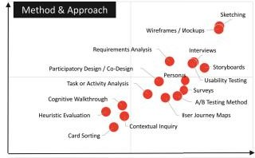




P. Parsons, "Understanding Data Visualization Design Practice," in IEEE Transactions
on Visualization and Computer Graphics, doi: 10.1109/TVCG.2021.3114959.

Slide 8
Heuristic Evaluation (Nielsen and Molich 1990)
A “discount usability engineering method” for quick, cheap, and
easy evaluation of a UI design
Most popular usability inspection method; yet is subjective
It is a systematic inspection of a design for usability
Meant to find the usability problems in the design so that they can be attended to as part of an iterative design process
Involves a small set of analysts judging the UI against a list of usability principles ("heuristics")

Slide 9
How to perform HE
Should be performed by several evaluators (one person will never be able to find all the problems)
Evaluators should work independently:
First get a general idea of the UI
Then perform a detailed inspection using a set of heuristics
Listing usability problems (heuristics not followed and severity degree)
Findings of all evaluators should be integrated in the same report
The report should help the development teem to prioritize problem fixing
http://www.nngroup.com/articles/how-to-conduct-a-heuristic-evaluation

Slide 10
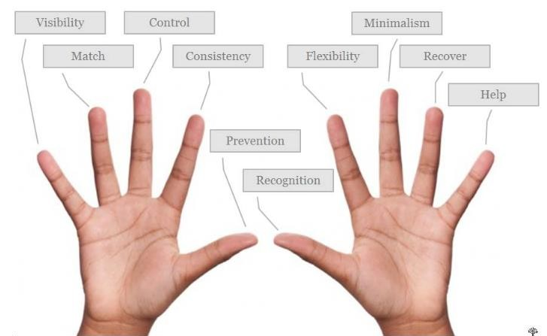
Nielsen proposed 10 general usability heuristics, yet there are other sets
(e.g., visualization, web, mobile applications for seniors or children…)
More details on how to conduct a heuristic evaluation at:
http://www.nngroup.com/articles/how-to-conduct-a-heuristic evaluation
And how to rate severity of the usability problems found:
http://www.nngroup.com/articles/how-to-rate-the-severity-of-usability-problems/
The list of problems and severity rates should help the development team to priorityse problem fixing

Slide 11
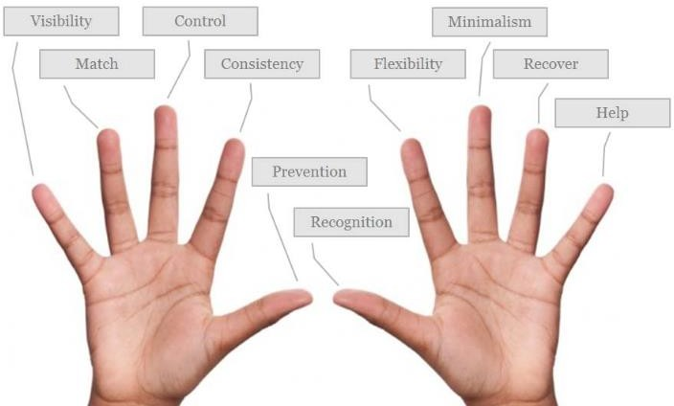
List of recognized usability principles (“the heuristics”)
Visibility of system status
Match between system and the real world 3-User control and freedom
4-Consistency and standards 5-Error prevention
Recognition rather than recall
Flexibility and efficiency of use 8-Aesthetic and minimalist design
Help users recognize, diagnose, and recover from errors
Help and documentation https://www.nngroup.com/articles/ten-usability-heuristics/

Slide 12
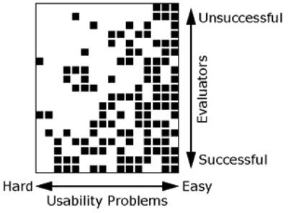
Number of problems found by several evaluators Example:
Heuristic evaluation of a banking system:
19 evaluators
16 usability problems
black square - problem found white square – not found
http://www.nngroup.com/articles/how-
to-conduct-a-heuristic-evaluation
Conclusion : in general 3 to 5 evaluators seems reasonable
More evaluators find more problems but cost more …
14

Slide 13
Specific Heuristics for Visualization
Zuk’s Perceptual and Cognitive heuristics (Zuk et al., 2006)
Forsell’s. heuristic set for evaluation in InfoVis (Forsell and Johanson, 2010)
Shneiderman’s “Visual Information-Seeking Mantra”
Freitas’s et al. Ergonomic Criteria for Hierarchical Information Visualization Techniques (Freitas et al., 2009)
Amar and Stasko’s Knowledge and task-based framework
...
15

Slide 14
Zuk and Carpendale’s (2006) heuristics
1-Ensure visual variable has sufficient length 2-Don’t expect reading order from color
3-Color perception varies with size of colored item 4-Local contrast affects color & gray perception
Consider people with color blindness
Preattentive benefits increase with field of view
Quantitative assessment requires position or size variation 8-Preserve data to graphics dimensionality
9-Put the most data in the least space 10-Remove the extraneous (ink)
Consider Gestalt Laws
Provide multiple levels of detail
Integrate text whenever relevant

Slide 15
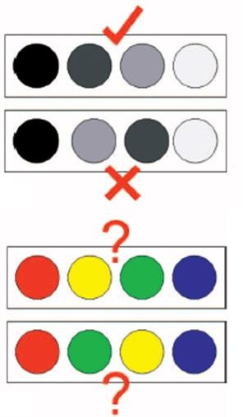
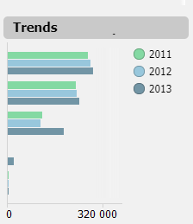

Explaining some of the Specific Heuristics for Visualization
Do not expect to easily perceive order from color
Visual variables must have sufficient length
Too small

Slide 16
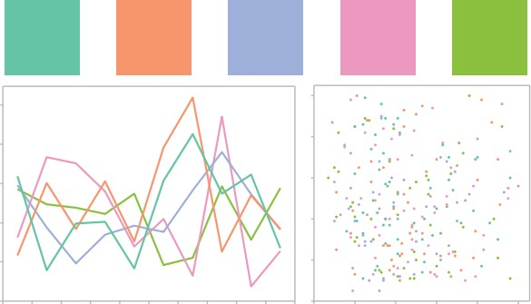
Color perception varies with size of colored item
A set of colors with different hues but equal luminance (L* = 72). In the squares, these colors are distinct and visually balanced (www.colorbrewer.org).
They are harder to distinguish in smaller items
Stone, M., “In color perception, size matters”, IEEE Computer
Graphics & Applications. 32, 2, 2012, pp. 8-13
19

Slide 17

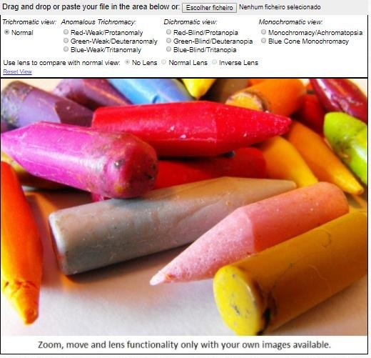


Consider people with color blindness
The most common form of color blindness is
deuteranopia (“daltonism”)
There are color blindness simulators
Normal vision
Deuteranopia
http://www.color-blindness.com/coblis- color-blindness-simulator
Tritanopia
http://www.colourblindawareness.org/

Slide 18


Quantitative assessment requires position or size variation
Position
Most accurate
Length
Angle
Slope
Area
Volume
Colour Density
Least accurate
The relative difficulty of assessing quantitative value as a function of encoding mechanism, as established by Cleveland and McGill (Spence, 2007)

Slide 19


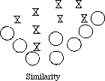



Gestalt Laws
Ambiguous stimuli tend to be resolved Using the simplest explanation
Near stimuli are perceived as a group
Stimuli tend to be grouped as to minimize variations or discontinuities
Similar stimuli tend to be grouped (may override proximity)
Regions delimited by symmetric tend to be perceived as coherent figures
22
Stimuli tend to be grouped in complete figures

Slide 20
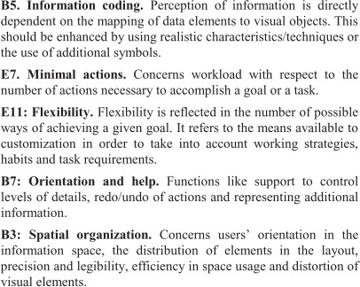
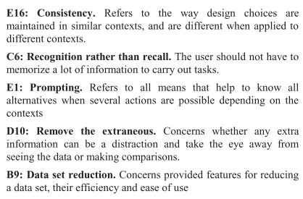
Forsell´s et al. (2010) heuristics
Uses heuristics from other sets:
B- Freitas et al.
C - Nielsen
D- Zuck and Carpendale
E- Bastien & Scapin
23

Slide 21
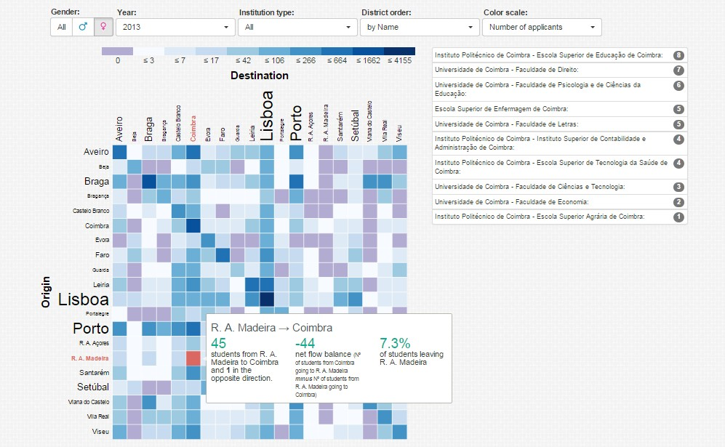
Example:
https://migration-flow.herokuapp.com/
IviDfG
This visualization is compliant with Zuk and Carpendale’ heuristics number 3 and 12, “Color perception varies with size of colored item” and “Provide multiple levels of detail”, respectively.
Nielsen´s heuristic number 4 “Consistency” is not complied with, as there are different
types of filter selection and the color scale varies depending on the filters applied.

Slide 22
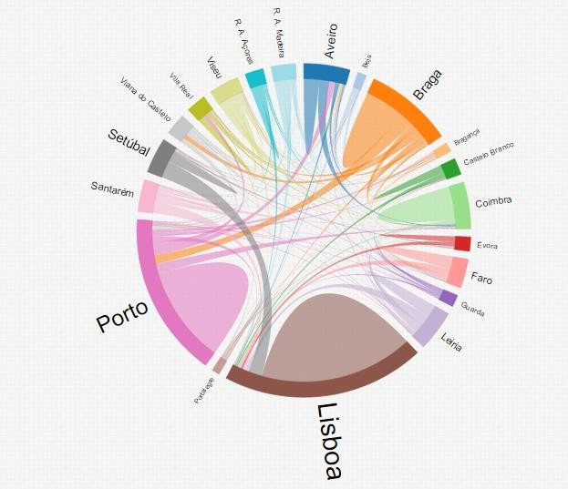
Example (cont.)
Zuk and Carpendale’s heuristic number 11 “Consider Gestalt Laws” is complied with,
heuristic number 1 ”Ensure visual variable has sufficient length” is not satisfied.
Nielsen´s heuristic number 2 “Match between system and the real world”, and Forsell and Johansson’s heuristic number 1 “Information Coding” are not satisfied

Slide 23
Practical activity on evaluation
(groups of 3 students)
Select a (preferably not very usable) Visualization/Visual Data Mining application and evaluate it using heuristic evaluation with one of these heuristics sets:
Nielsen
Zuk et al.
Other …
You may find interesting examples at:
Tableau public – gallery
Spotfire – gallery
…
Each evaluator should read carefully and try to understand each heuristic and analyze independently the application registering the potential problems and their classification
Discuss the problems with the other group members and consolidate a list of problems
Prepare a 5 min presentation with the main potential problems you found

Slide 24
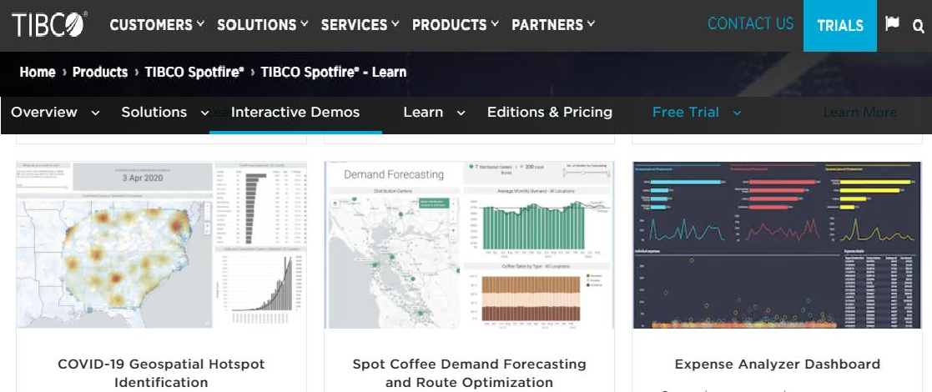
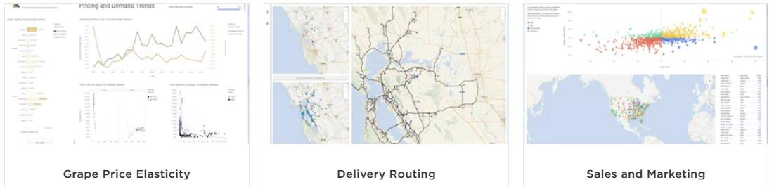
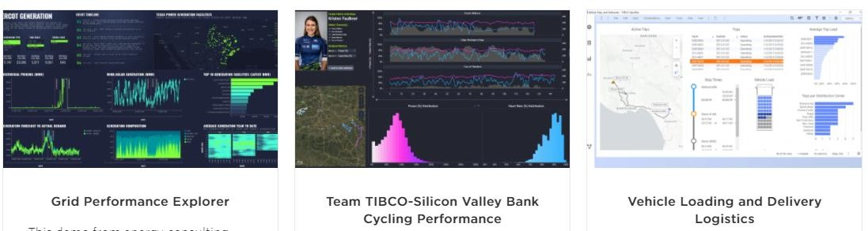
https://www.tibco.com/products/tibco-spotfire/learn/demos
27

Slide 25
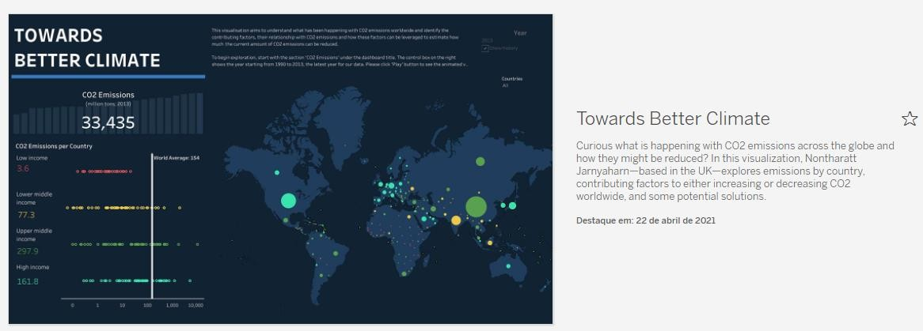
https://public.tableau.com/en-us/s/gallery

Slide 26
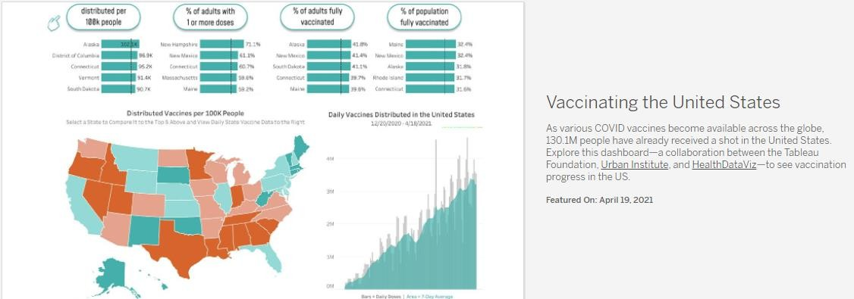
Example: vaccinating the united states
https://public.tableau.com/en-us/gallery/vaccinating-united-
states?tab=viz-of-the-day&type=viz-of-the-day

Slide 27
Usability tests
“Engineering approach”
Involve observation and query
Main aspects:
Participants
Tasks
Test facilities and systems
Experimental design
Usability measures
Data analysis
May have a complex logistics

Slide 28
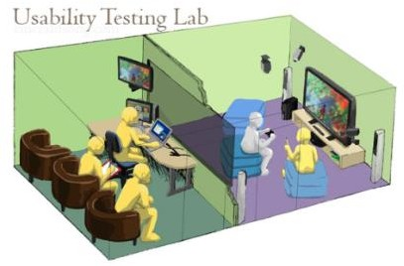
Observation
Has many variants from very simple
to very complex and expensive:
Direct: observer takes notes
Indirect: through audio/ video – more complex and time consuming
Think Aloud: users are asked to explain what they are doing
Logging: users activity is logged by the system
Combinations of the previous, etc.

Slide 29

Query
Two main variants:
Questionnaire
(reach more people; less flexible)
Interview
Should always be carefully prepared and tested
Collected data should be carefully analyzed
https://www.interaction-design.org/literature/article/useful-survey-questions-for- user-feedback-surveys
https://www.interaction-design.org/literature/article/how-to-conduct-user-interviews

Slide 30

Well-known usability questionnaires
System Usability Scale (SUS)
Questionnaire for User Interface Satisfaction (QUIS)
SUS provides a “quick and dirty”, reliable tool for measuring the usability
It includes 10 questions with five response options
QUIS is designed to assess a user's subjective satisfaction with the UI
It is designed to be configured according to the needs of each UI analysis by
including only the sections that are of interest to the user
Both questionnaires should be completed following use of the UI in question
33

Slide 31
System Usability Scale (SUS)
Provides a “quick and dirty”, reliable tool for measuring the usability
It includes 10 questions with five response options
It allows to evaluate a wide variety of products and services (H/W, S/W, mobile devices, websites and applications)
Has become an industry standard, with references in over 1300 publications
Benefits of using a SUS
Is a very easy scale to administer to participants
Can be used on small sample sizes with reliable results
Is valid – it can differentiate between usable and unusable systems
https://www.usability.gov/how-to-and-tools/methods/system-usability-scale.html

Slide 32
SUS Questions
I think that I would like to use this system frequently.
I found the system unnecessarily complex.
I thought the system was easy to use.
I think that I would need the support of a technical person to be able to use this system.
I found the various functions in this system were well integrated.
I thought there was too much inconsistency in this system.
I would imagine that most people would learn to use this system very quickly.
I found the system very cumbersome to use.
I felt very confident using the system.
I needed to learn a lot of things before I could get going with this system.
https://www.usability.gov/how-to-and-tools/resources/templates/system-
usability-scale-sus.html

Slide 33
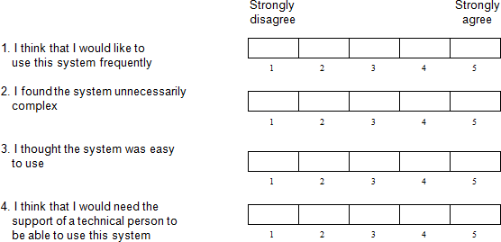
Scoring SUS
Note that:
odd numbered questions represent positive aspects and
even numbered questions negative aspects…

Slide 34

Scoring SUS
SUS provides a value in [0-100]
To obtain the value:
Add the scores of all questions:
odd numbered questions - subtracting 1 from the score
even numbered questions - subtracting their value from 5
Multiply the sum by 2.5.
SUS > 68 would be considered above average
37

Slide 35
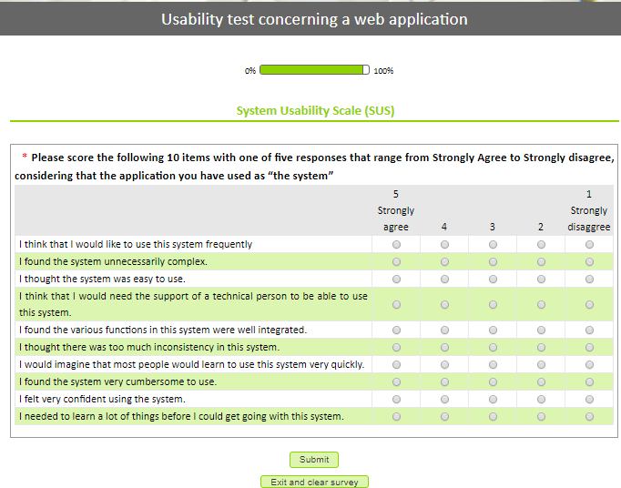
38

Slide 36
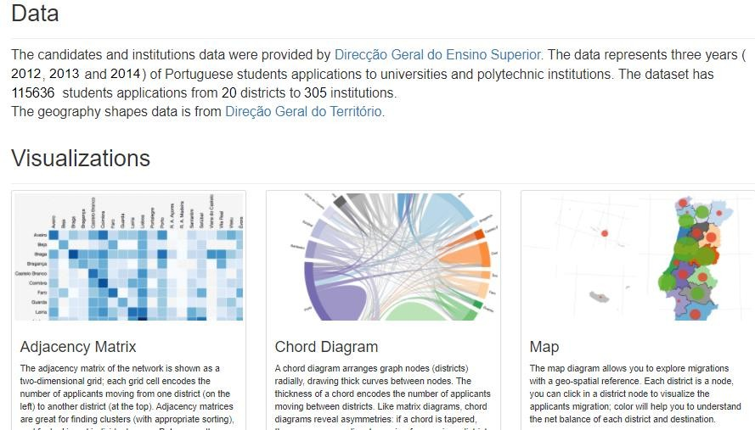
Example of a usability test of a visual exploration app
based on a web questionnaire to be answered by a user while observed by an experimenter
https://forms.ua.pt/index.php?r=survey/index&sid=489227
39

Slide 37
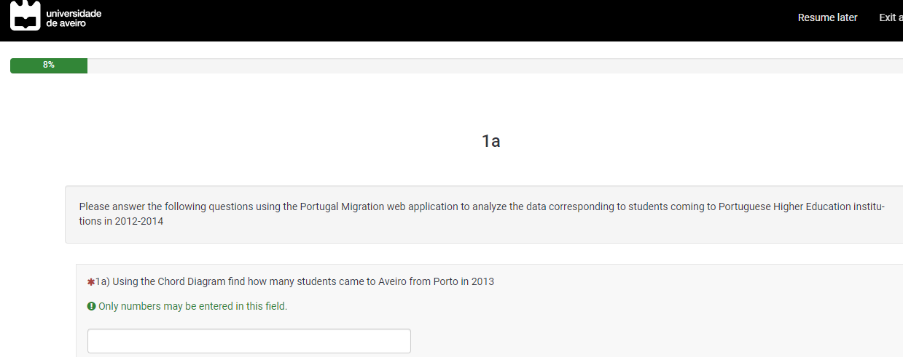
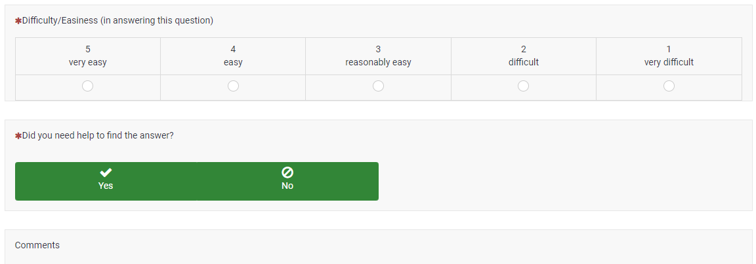
Main steps:
Informed
consent
Tasks to perform Using the application
Was it difficult?
Needed help?
Any comments?

Slide 38
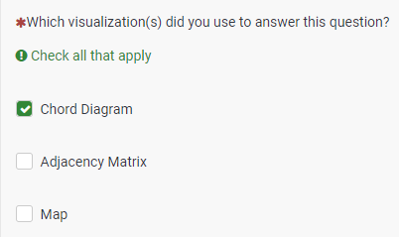
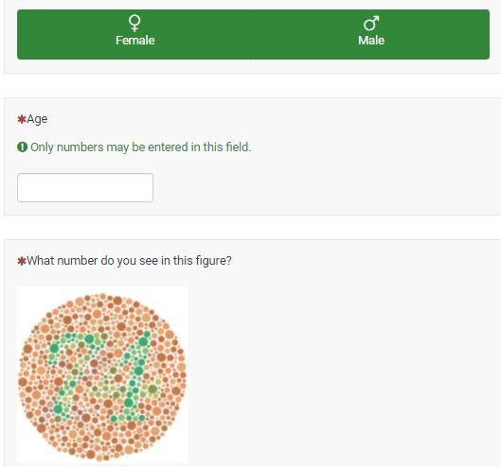
What vis technique did you use?:
Demographic
data

Slide 39
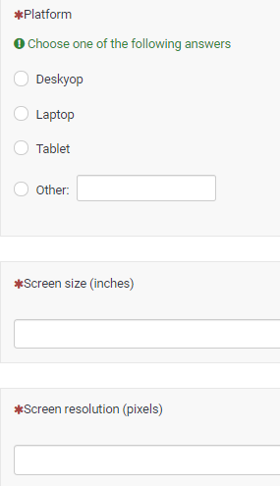
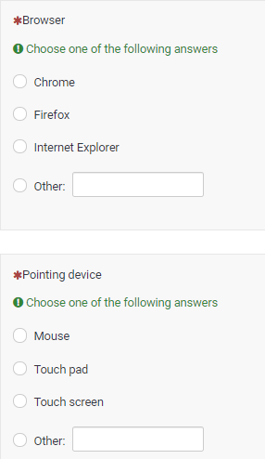
About H/W and S/W

Slide 40
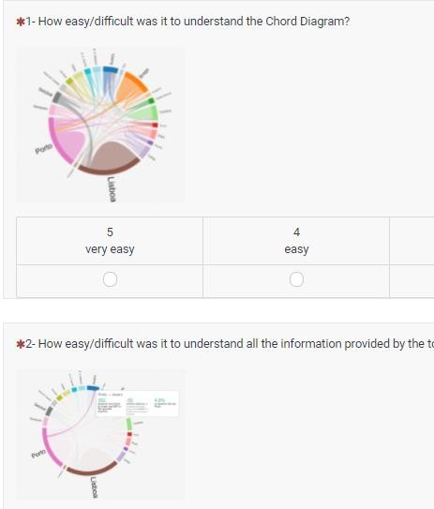
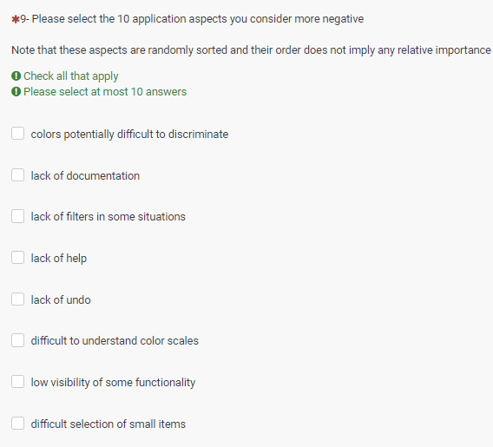
Questions about the application

Slide 41
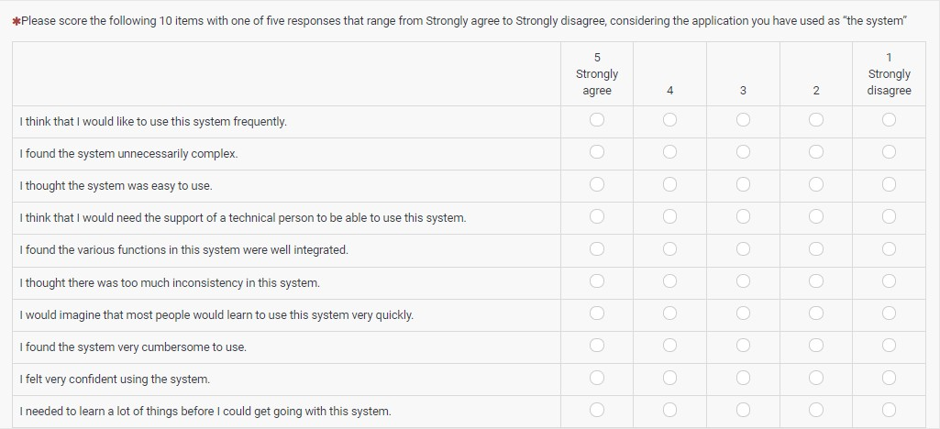
Final questionnaire about the application usability (SUS)

Slide 42
Controlled experiments
The work horse of experimental science ...
Important issues to consider:
Hypothesis
Variables (input or independent; output or dependent)
Secondary variables
Experimental design (within groups; between groups)
Participants (number, profile)
Statistics

Slide 43
Controlled experiment
Define an hypothesis
Define input (independent), output (dependent) and secondary variables
Define experimental design (within-groups / between groups)
Select the participants
Prepare all the documentation:
- informed consent
list of tasks and perceived difficulty
final questionnaire
list of tasks for the observer to take notes
To the user
To the observer
Run a pilot test
Take care of the logistics
… and after the experiment analyze data

Slide 44
Participants
Important issues in usability tests and controlled experiments:
The total number of participants to be tested
(a valid statistical analysis implies a sufficient number of subjects)
Segmentation of user groups tested, if more than one
Key characteristics and capabilities of user group
(user profile: age, gender, computing experience, product experience, etc.)
How to select participants
Differences between the participant sample and the user population
(e.g. actual users might have training whereas test subjects were untrained)

Slide 45
Tasks
The task scenarios for testing (or experiments)
Why these tasks were selected
(e.g. the most frequent tasks, the most troublesome tasks)
The source of these tasks
(e.g. observation of users using similar products, product specifications)
Any task data given to the participants
Completion or performance criteria established for each task
(e.g. n. of clicks < N, time limit)

Slide 46
Test Facilities and equipment
The setting and type of space in which the evaluation will be done
(e.g. usability lab, cubicle office, meeting room, home office, home family room, manufacturing floor, etc.)
Any relevant features or circumstances that can affect the results
(e.g. video and audio recording equipment, one-way mirrors, or automatic
data collection equipment)
Participant’s Computing Environment
(e.g. computer configuration, including model, OS version, required libraries
or settings, browser name and version; relevant plug-in, etc. )
Display and input devices characteristics
Any questionnaires to be used

Slide 47
Experimental design
Procedure/ protocol: the logical design of the test/experiment
Participant general instructions and task instructions
The independent variables and control variables
The usability measures to be used:
a) for effectiveness (completeness rate, errors, assists…)
b) for efficiency (times)
c) for satisfaction

Slide 48

We know issues and methods, but how to use them?
A nested model for visualization design and validation:
This model can be used :
to analyze existing systems or papers, or
to guide the design process
Provides explicit guidance on what evaluation methodology is appropriate
and identifies threats to validity at each level
Munzner, T.. A nested model for visualization design and validation. IEEE
Transactions on Visualization and Computer Graphics. 15, 6, 2009, pp. 921–8
51

Slide 49



Four levels for visualization design and validation
characterize the tasks and data in the vocabulary of the problem domain,
abstract into operations and data types,
design visual encoding and interaction techniques,
create algorithms to execute these techniques with efficiency and efficacy
3 design levels

Slide 50
In each of the four levels it is necessary to :
1- learn about the tasks and data of target users in some particular target
domain,
2- map problems and data from the vocabulary of the specific domain into a more abstract description in the vocabulary of computer science (e.g. filter, retrieve value, sort, find extrema, etc.)
3- design the visual encoding, presentation and interaction,
4- create an algorithm to carry out the visual encoding and interaction designs automatically. The issues of algorithm design are not unique to visualization .

Slide 51
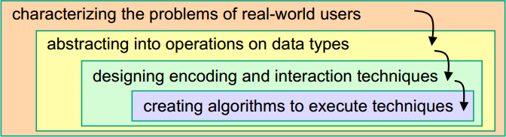
This split into levels is motivated by shared threats to validity at each one:
Wrong problem: they don't do that;
Wrong abstraction: you're showing them the wrong thing;
Wrong encoding/interaction: the way you're showing the thing doesn't work;
Wrong algorithm: your code is not adequate (e.g. too slow).

Slide 52
Output from a level above is input to the level below
An upstream error inevitably cascades to all downstream levels:
E.g. a poor choice in the abstraction stage will not create a visualization system that solves the intended problem, even with perfect visual encoding and algorithm design .

Slide 53
Evaluating Visualizations is challenging
It will become more challenging as Visualization evolves to be more interactive, collaborative, distributed, multi-sensorial, mobile …
It is fundamental to:
evaluate solutions to specific cases
develop new visualization methods / systems
establish guidelines
- i.e. to make Visualization more useful, more usable, and more used

Slide 54
Usability Evaluation Bibliography - Papers
Carpendale, S., “Evaluating Information Visualizations,” in Information Visualization , Human-centered issues and perspectives, A. et al. Karren, Ed. Springer, 2008, pp. 19–45.
Cockton, G. Usability Evaluation. In: Soegaard, Mads and Dam, Rikke Friis (eds.),
The Encyclopedia of Human-Computer Interaction, 2nd Ed, 2013, Aarhus,
Denmark: The Interaction Design Foundation, 2013
http://www.interaction-design.org/encyclopedia/usability_evaluation.html
Zuk, T., L. Schlesier, Neumann, P., Hancock, M. and Carpendale, S. Heuristics for
Information Visualization Evaluation,” in First Workshop on Beyond Time and Errors
Novel Evaluation Methods for Visualization BELIV’06, 2006, pp. 1–6.

